Slide 1
Chapter 2 Configuration Space
Chapter 3 Rigid-Body Motions
Chapter 4 Forward Kinematics
Chapter 5 Velocity Kinematics and Statics
Chapter 6 Inverse Kinematics
Chapter 7 Kinematics of Closed Chains
Chapter 8 Dynamics of Open Chains
Chapter 9 Trajectory Generation
9.1 Definitions
9.2 Point-to-Point Trajectories
9.3 Polynomial Via Point Trajectories
9.4 Time-Optimal Time Scaling
Chapter 10 Motion Planning
Chapter 11 Robot Control
Chapter 12 Grasping and Manipulation
Chapter 13 Wheeled Mobile Robots

Slide 2

Important concepts, symbols, and equations
Time-optimal time scaling: Find the time scaling s(t) that moves the robot along a path from 𝜃(0) to 𝜃(1) in minimum time, given the robot’s dynamics and actuator limits.
Dynamics:
Dynamics along the path:

Slide 3
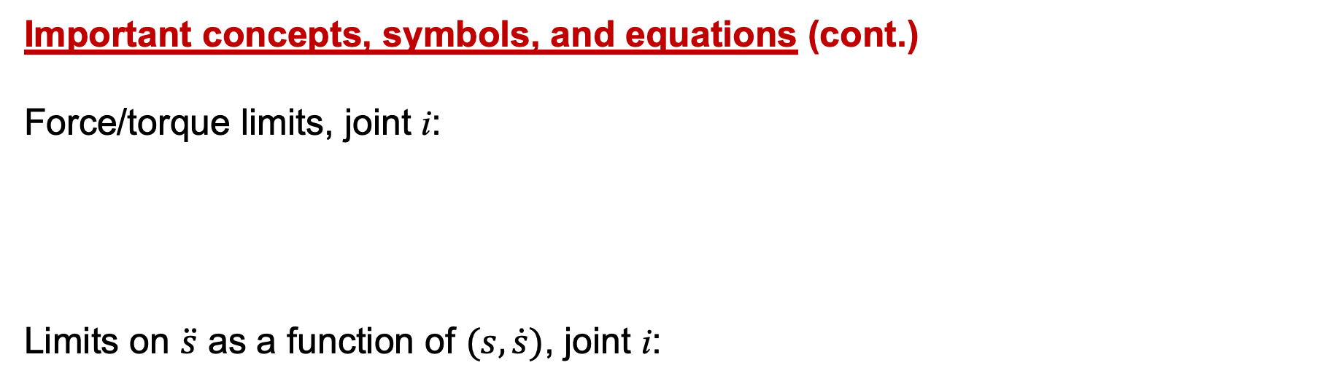
Important concepts, symbols, and equations (cont.)
Force/torque limits, joint i:
Limits on $\ddot{s}$ as a function of $(s,\dot{s})$, joint i:

Slide 4
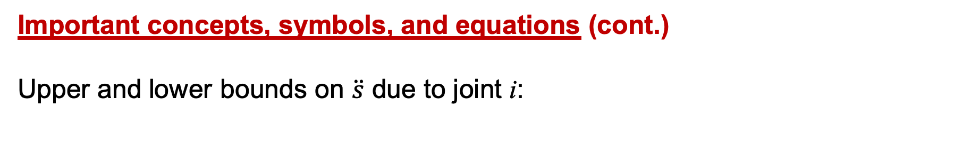
Important concepts, symbols, and equations (cont.)
Upper and lower bounds on $\ddot{s}$ due to joint i:

Slide 5
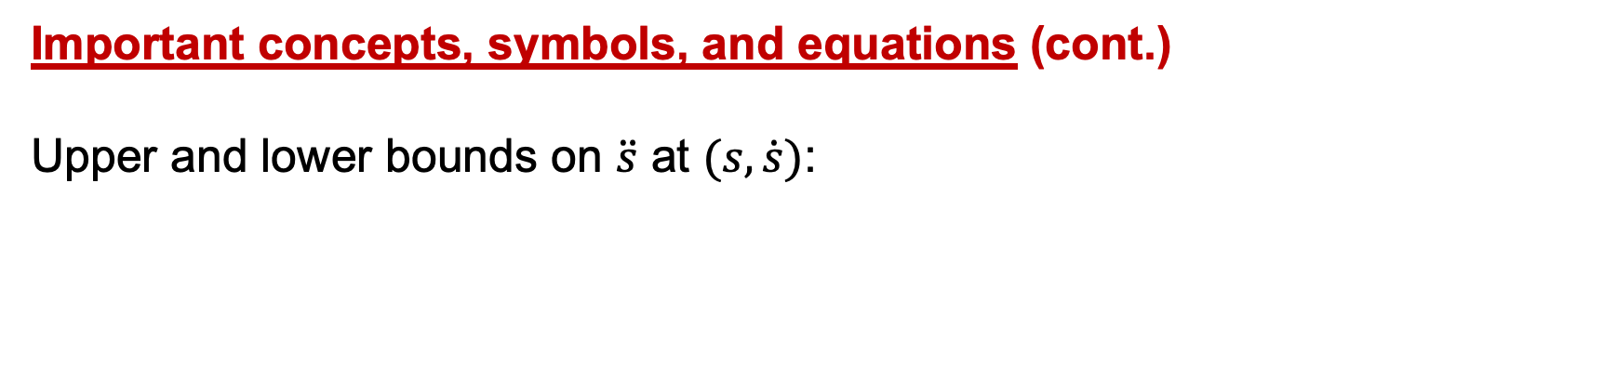
Important concepts, symbols, and equations (cont.)
Upper and lower bounds on $\ddot{s}$ at $(s,\dot{s})$:

Slide 6
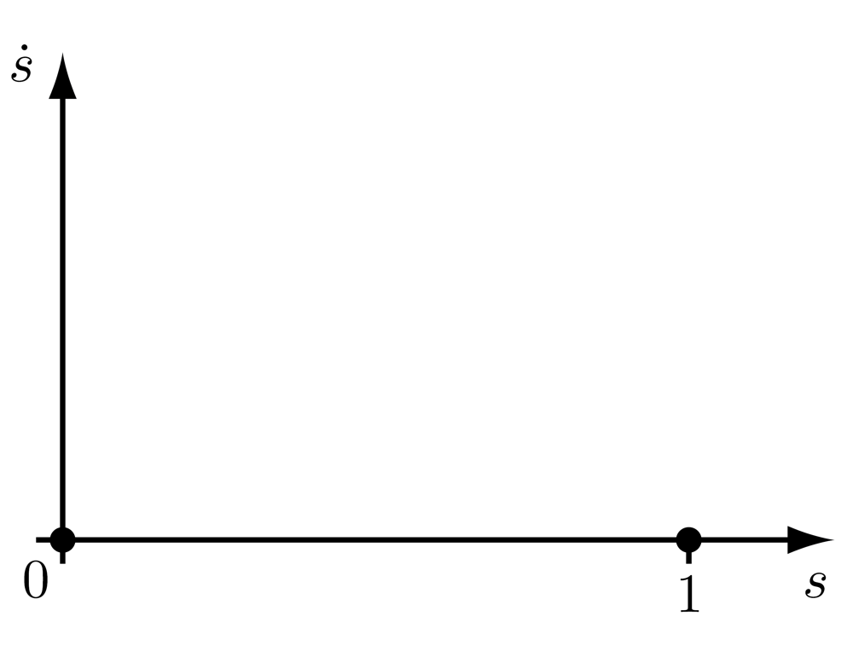
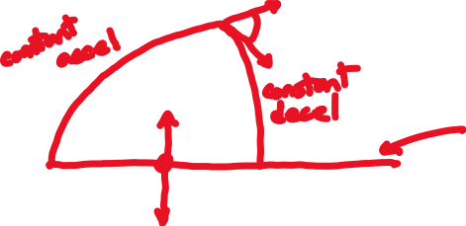

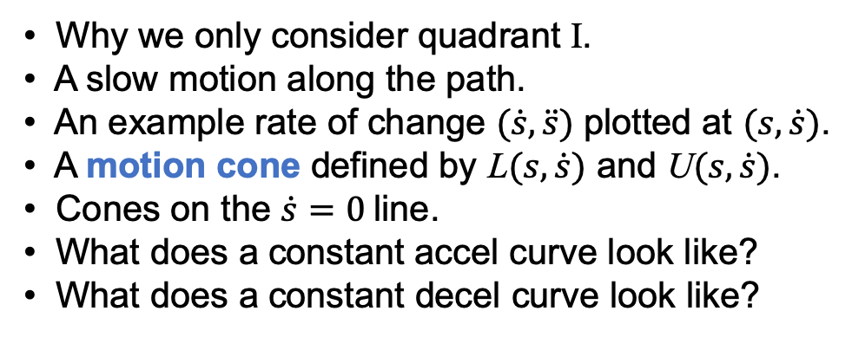
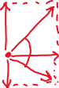
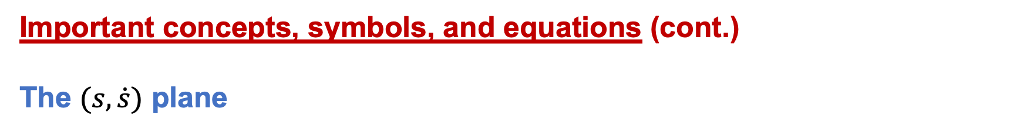
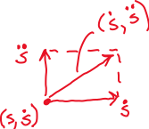
Important concepts, symbols, and equations (cont.)
The $(s,\dot{s})$ plane
• Why we only consider quadrant I.
• A slow motion along the path.
• An example rate of change $(\dot{s},\ddot{s})$ plotted at $(s,\dot{s})$.
• A motion cone defined by L$(s,\dot{s})$ and U$(s,\dot{s})$.
• Cones on the $\dot{s}=0$line.
• What does a constant accel curve look like?
• What does a constant decel curve look like?

Slide 7
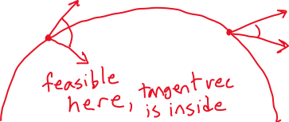
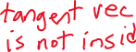
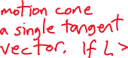
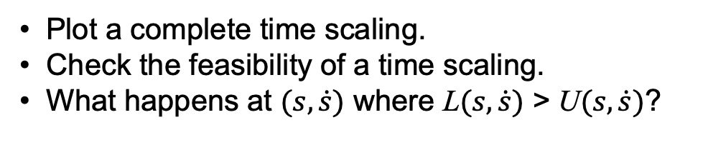
Important concepts, symbols, and equations (cont.)
The $(s,\dot{s})$ plane
• Plot a complete time scaling.
• Check the feasibility of a time scaling.
• What happens at $(s,\dot{s})$ where L$(s,\dot{s})$ > U$(s,\dot{s})$?

Slide 8
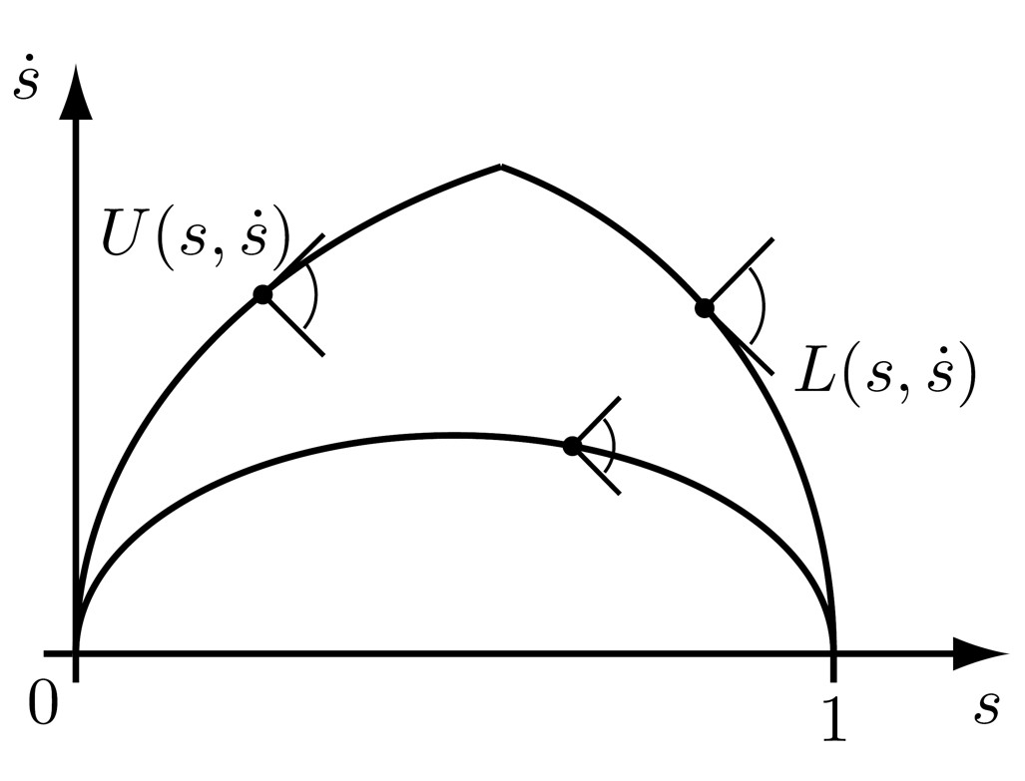
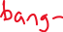
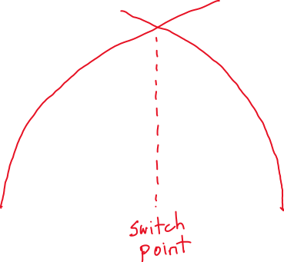
Important concepts, symbols, and equations (cont.)
time-optimal time scaling
not time optimal

Slide 9
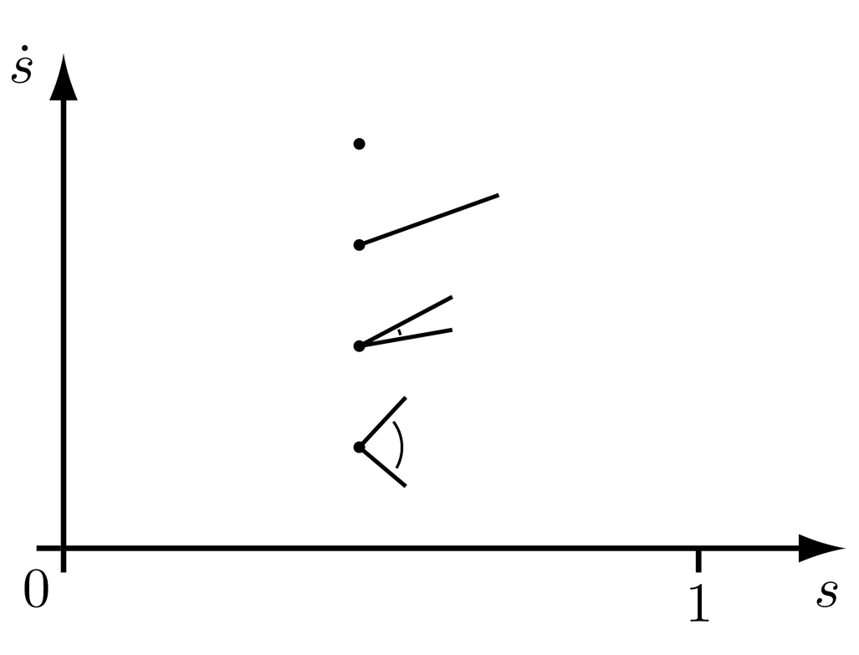
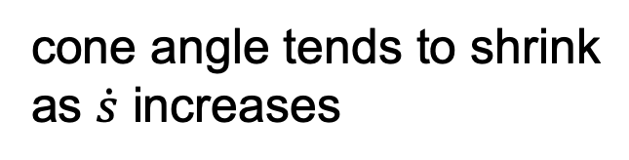
Important concepts, symbols, and equations (cont.)
cone angle tends to shrink
as $\dot{s}$ increases

Slide 10
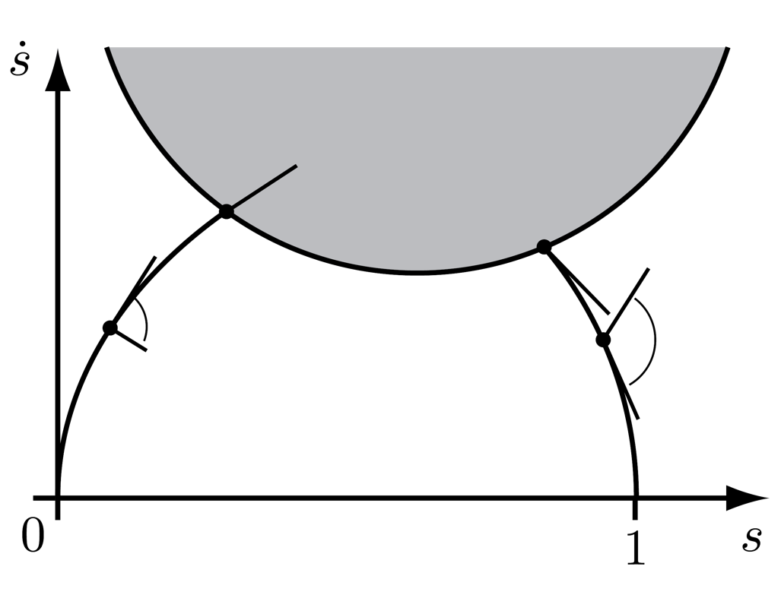
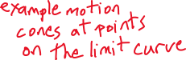
Important concepts, symbols, and equations (cont.)
velocity limit curve where the
cone is only a single tangent vector

Slide 11
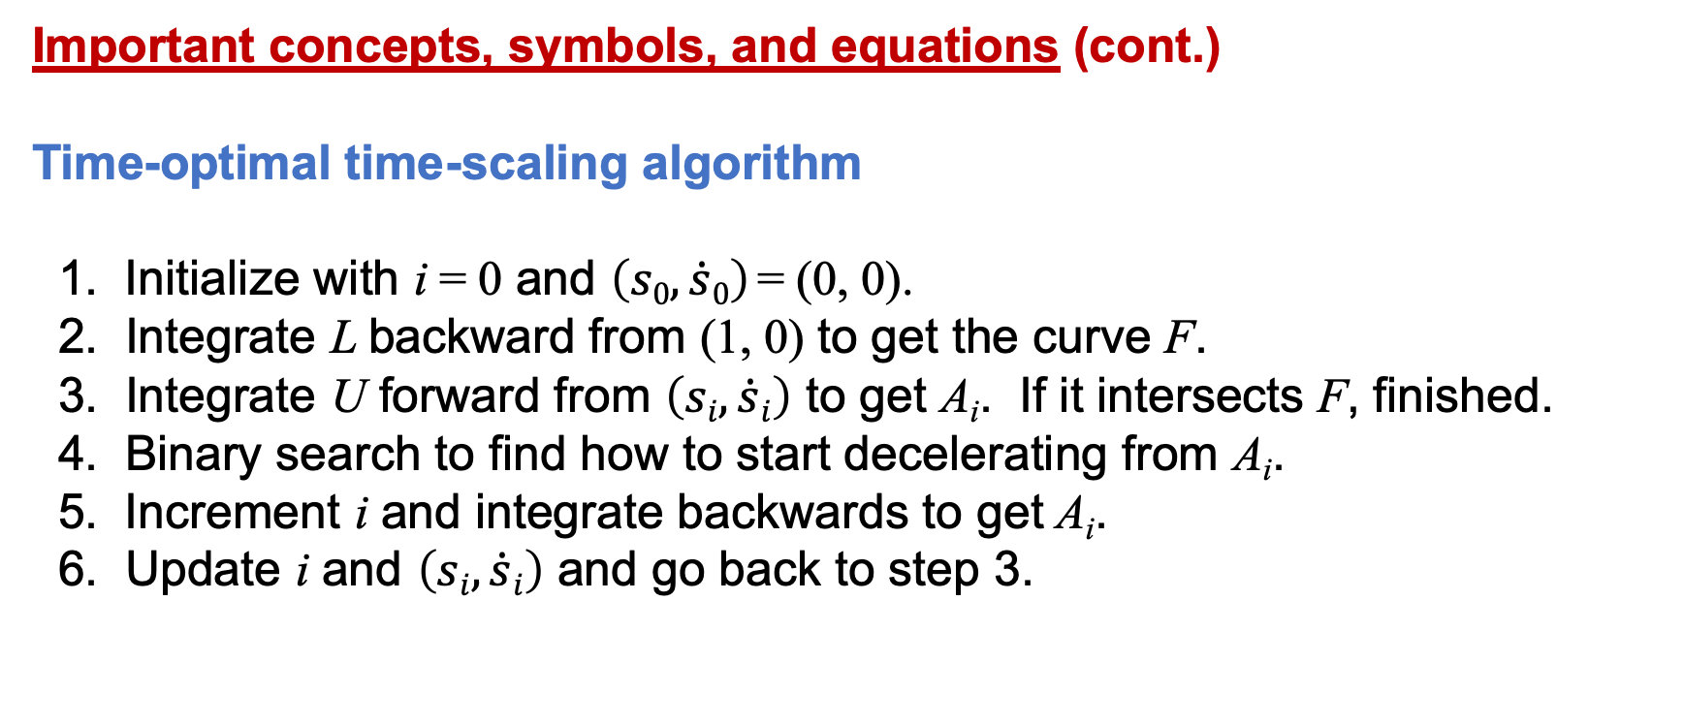
Important concepts, symbols, and equations (cont.)
Time-optimal time-scaling algorithm
1. Initialize with i = 0 and $\left(s0,\dot{s}0\right)$= (0, 0).
2. Integrate L backward from (1, 0) to get the curve F.
3. Integrate U forward from $\left(si,\dot{s}i\right)$ to get A_{i}. If it intersects F, finished.
4. Binary search to find how to start decelerating from A_{i}.
5. Increment i and integrate backwards to get A_{i}.
6. Update i and $\left(si,\dot{s}i\right)$ and go back to step 3.

Slide 12
Important concepts, symbols, and equations (cont.)

Slide 13
Important concepts, symbols, and equations (cont.)

Slide 14
Important concepts, symbols, and equations (cont.)

Slide 15

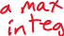
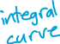
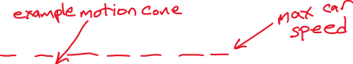
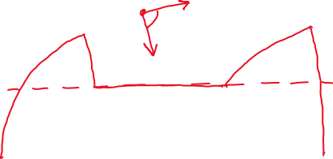
Draw the legal
time-optimal
time scaling for
a driver rushing
home with
the max braking
and max
acceleration
integral curves
shown.

Slide 16




time-optimal
time scaling
1. Where do we know how to draw the motion cones, just from this plot?
2. Where is the robot able to stay on the path, but is doomed to leave it?
3. Can we get back to the optimal time scaling by the trajectories shown from A, B, C?

